Slide 1



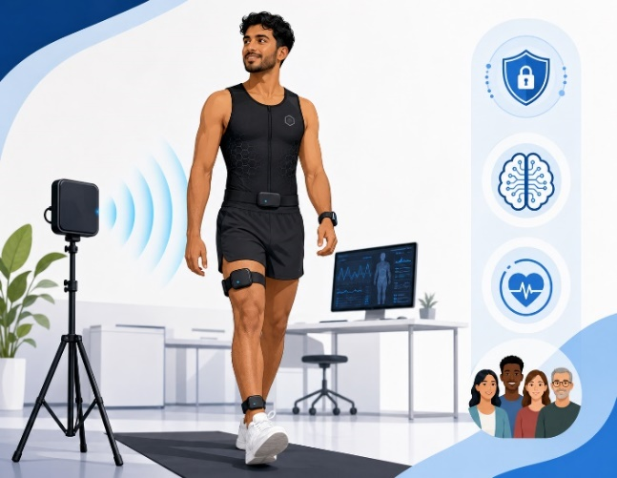
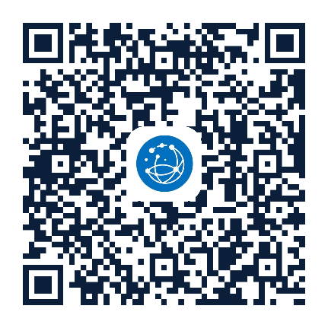
Participants needed to help us advance AI models for smart human sensing
Human Digital Twin Intelligence: Integrating Multimodal AI and Generative Models for Non-Intrusive Health and Activity Monitoring
The study involves wearing smart wearable devices to record body movements and vital signs while performing a set of physical activities.
The data collected will be used to develop multimodal AI for human activity and vital sign analysis and understanding.
Gift voucher for your participation
When: Flexible dates/times
Duration: 1 hour
Location:
AUT WZ Leve 1 Lab
To learn more, please contact
Mr. Mohammad Shirazi
Mobile. +64 2902202024
Email: hossein.shirazi@autuni.ac.nz
Eligibility: Healthy adults aged 18+ who can safely perform everyday movements
This research has been approved by AUTEC, Ethics Application No. 26/144
CONTACT Mohammad Shirazi
Email: hossein.shirazi@autuni.ac.nz
Mobile: +64 2902202024
CONTACT Mohammad Shirazi
Email: hossein.shirazi@autuni.ac.nz
Mobile: +64 2902202024
CONTACT Mohammad Shirazi
Email: hossein.shirazi@autuni.ac.nz
Mobile: +64 2902202024
CONTACT Mohammad Shirazi
Email: hossein.shirazi@autuni.ac.nz
Mobile: +64 2902202024
CONTACT Mohammad Shirazi
Email: hossein.shirazi@autuni.ac.nz
Mobile: +64 2902202024
CONTACT Mohammad Shirazi
Email: hossein.shirazi@autuni.ac.nz
Mobile: +64 2902202024
CONTACT Mohammad Shirazi
Email: hossein.shirazi@autuni.ac.nz
Mobile: +64 2902202024
CONTACT Mohammad Shirazi
Email: hossein.shirazi@autuni.ac.nz
Mobile: +64 2902202024

